Slide 1

customer activation and retention
E-retail factors for customer activation and retention: A case study from Indian e-commerce customers
By:- kunal chand

Slide 2
INTRODUCTION
Customer satisfaction has emerged as one of the most important factors that guarantee the success of online store; it has been posited as a key stimulant of purchase, repurchase intentions and customer loyalty. A comprehensive review of the literature, theories and models have been carried out to propose the models for customer activation and customer retention. Five major factors that contributed to the success of an e-commerce store have been identified as: service quality, system quality, information quality, trust and net benefit. The research furthermore investigated the factors that influence the online customers repeat purchase intention. The combination of both utilitarian value and hedonistic values are needed to affect the repeat purchase intention (loyalty) positively. The data is collected from the Indian online shoppers. Results indicate the e-retail success factors, which are very much critical for customer satisfaction.

Slide 3
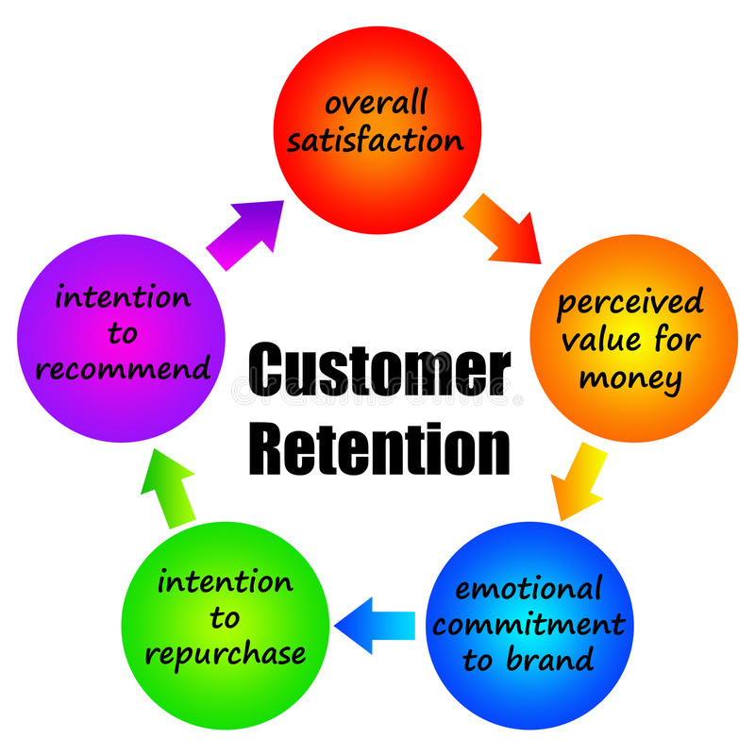
Factors for customer retention

Slide 4
. Five major factors that contributed to the success of an e-commerce store have been identified as:
1. Overall satisfaction
2. Precede value for money
3. Emotional commitment to brand
4. Intension to repurchase
5. Information quality and intension to recommend.

Slide 5
Data Exploration
Data exploration is the first step in data analysis and typically involves summarizing the main characteristics of a data set, including its size, accuracy, initial patterns in the data, and other attributes
It is commonly conducted by data analysts using visual analytics tools, but it can also be done in more advanced statistical software, Python.
An initial exploration of the data set can help answer these questions by familiarizing analysts with the data with which they are working

Slide 6
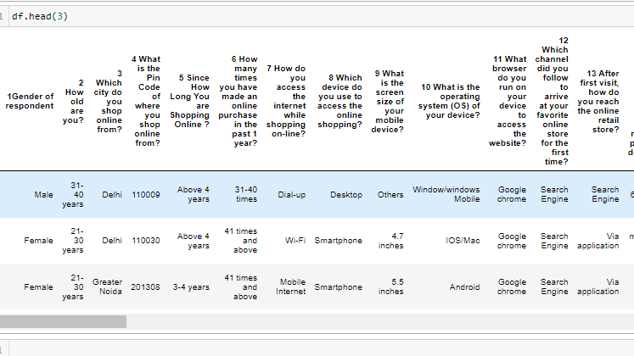
Data Sources and their formats
Most of the time data is in CSV file.
Then we load it in the system using python notebook and frame the data in data frame using pandas.

Slide 7
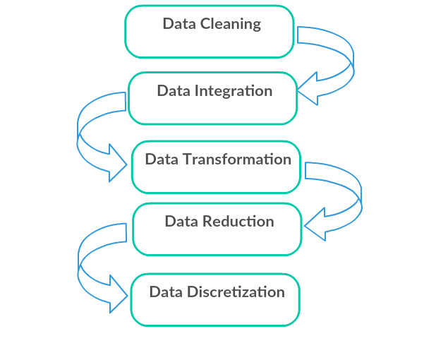
Data Pre-processing Done
Data pre-processing can refer to the manipulation or dropping of data before it is used to ensure or enhance performance, and is an important step in the data mining process.

Slide 8
Data Cleaning: First we clean the data which have no use in prediction like the ID column, then we drop the data which has a high no of missing percentages.
Data Integration: then we do some EDA process for finding out the meaning full insights of the data.
Data transformation is the process of changing the format, structure, or values of data; we use a labelled encoder for coding the object data into integer data.
Data Reduction: it is the process of finding the most correlated columns, and combining them because the machine does not understand which feature columns impact the most on accuracy.
Data discretization converts a large number of data values into smaller once, so that data evaluation and data management becomes very easy, using box plots is makes a clear understanding of the data.

Slide 9
EDA Concluding Remark
Data Analysis is always the important part, for better understanding different kinds of bar plots, distribution plots are created with the target Column for finding the insights of the dataset we have.
Analytical Modeling always starts with the target variable we have, and in that case, our target variable is Repeat Purchase, for that, we create some box plots with the target variable to understand which feature columns

Slide 10
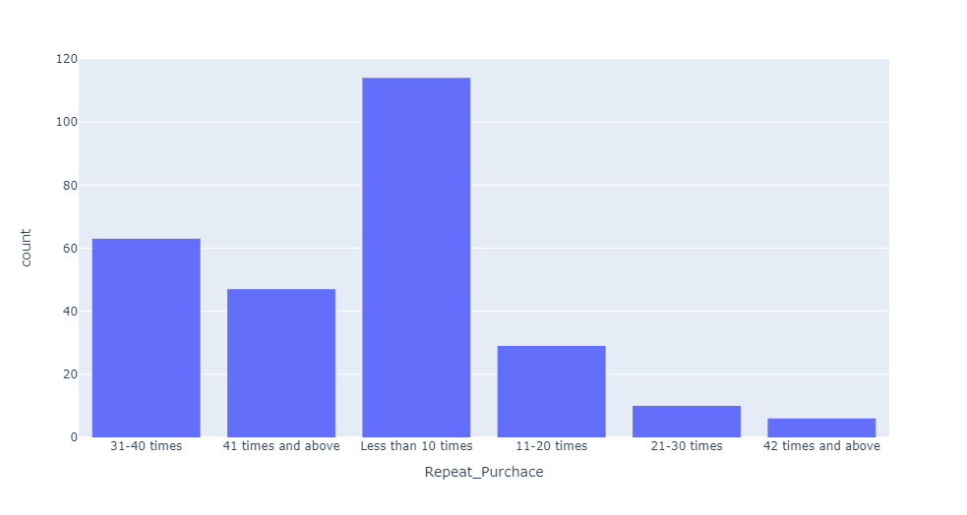
Visualization.
Visiting Frequency

Slide 11
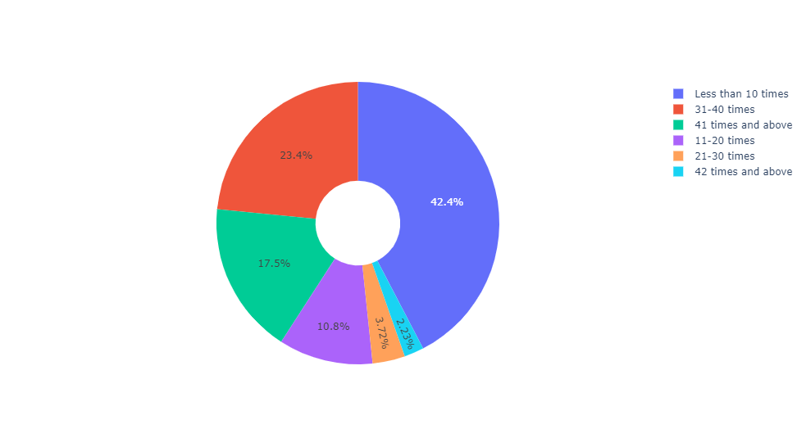
Lets plot the pie plot and note the percentage of repeat purchase.
42.4% are those who only purchase 10 times.
2.23% are those who purchased more than 41 times.

Slide 12
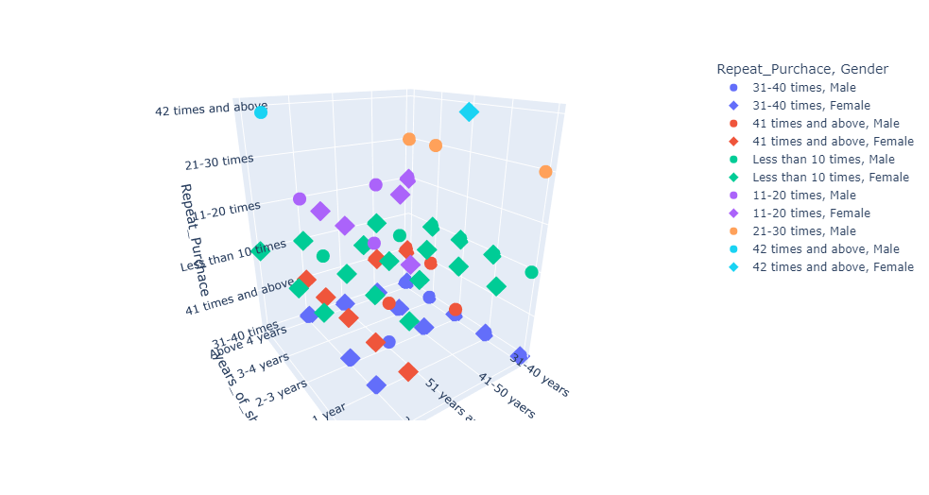
Lets visualize Repeat purchase with Age and gender column.

Slide 13
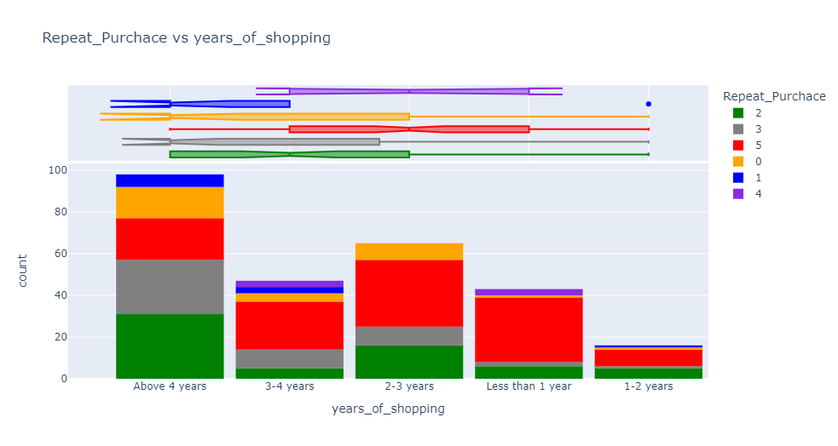
Plot the box plot between repeat purchase and years of shopping.

Slide 14
observations
This plot gives the following results.
More no of years gives more no of purchase.
Less years of shopping gives less no of purchase.

Slide 15
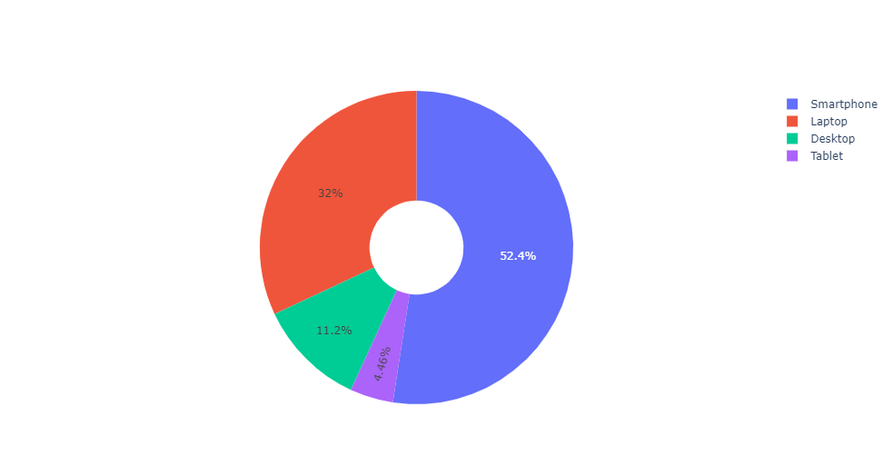
For retention there are following areas to focus.
Device used for purchase

Slide 16
Observations.
From above plotting we observe that smart phones used is more then 50%,for retention website should be user friendly and convenient to use.
laptops and destock on 2nd and 3rd positions.
Tablets are used less for shopping.

Slide 17
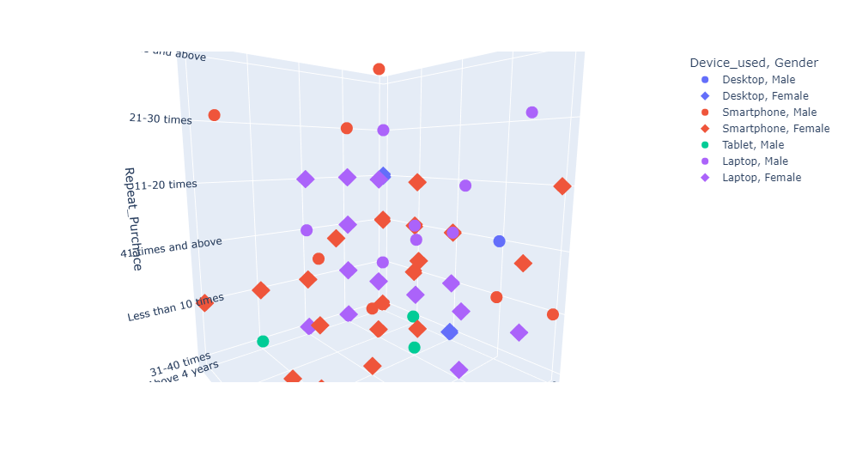
Repeat purchase with used device.

Slide 18
Observations..
From above plotting we easily find that smart phones are the only device which used for repeat purchase 42 times and more.
Laptops are on second in our list and used for 21-30 times for repeat purchase.

Slide 19
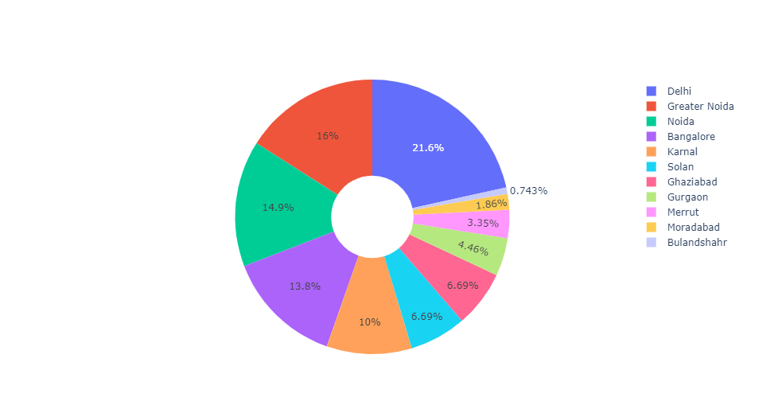
location

Slide 20
observations
Major cities are where maximum buying happens.
1. Delhi
2. Greater Noida
3. Noida
4. Bangalore.
When comes to shopping big cities are purchased more.
Metropolitan cities are more aware of online shopping and hence companies focus more on big cities for customer activation.

Slide 21
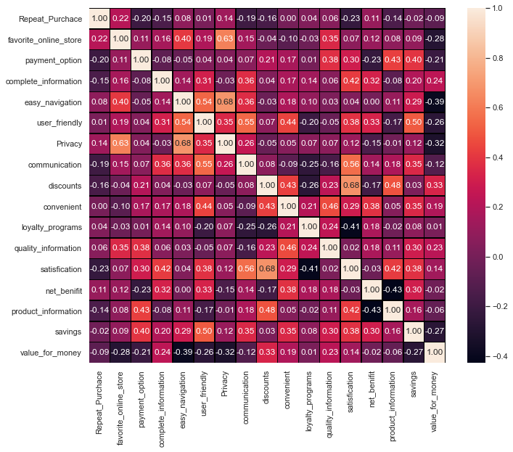
CORRELATION BETWEEN THE COLUMNS.

Slide 22
Observations.
1. From above heat map we observe that favorite online store, easy navigation, privacy, loyalty programs, quality information and net benefit makes customer purchase on a repeat note.
2. For customer activation these are some features where online industries should have to focus.

Slide 23
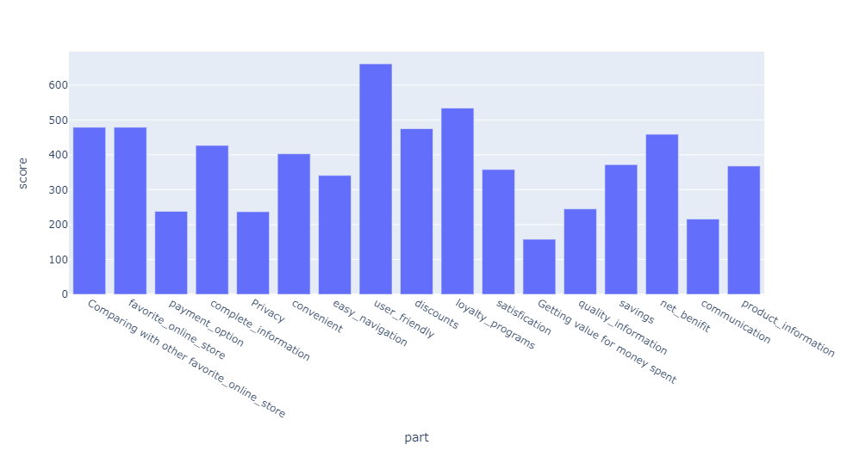
Options where companies have to focus for more customer activation and retentions.

Slide 24
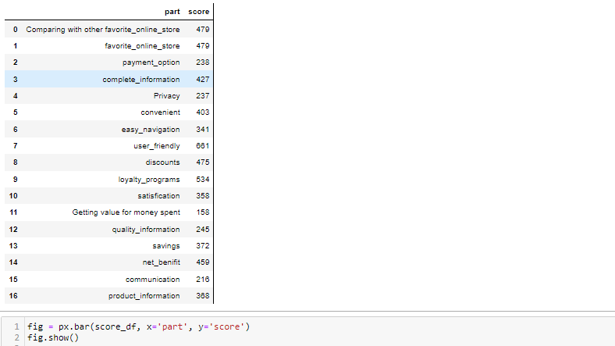
Table of scores of most important features.

Slide 25
Which part satisfies customers the most?
1.Those websites are user friendly having more no of repeat customers.
User friendly scores 661 points which is best from rest of the options.
Which part satisfies customers the least?
Value for money , those websites not give value for money options are not retaining the customers.
Value for money scores 158 points.

Slide 26
Conclusion:
1.When customers find website user friendly they visit more and more, which makes then loyal customer.
2.When they find what they get is not value for money them don't buy and leave the cart empty.
3.More time spent on website makes them buy more.
4.Most user buys in less then 10 minutes which means what they want they find easily which means product information is must have feature.
5. Loyalty programs and Discounts makes them repeat purchase from website, which means those website gives timely discounts have more customers.
6. Net benefit is also the must have feature it increases the repeat purchase.

